Slide 1
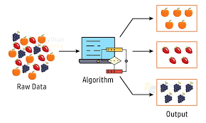
Module – 5
Clustering Algorithms

Slide 2
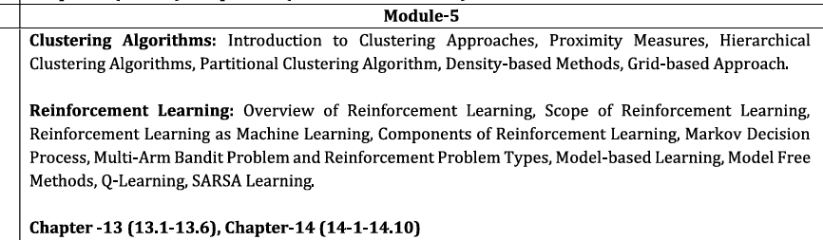

Slide 3
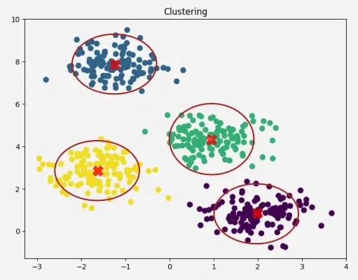
CLUSTERING
You are working for an e-commerce company like Amazon.
You have customer data:
Age
Purchase amount
Browsing time
Product categories
But there are no labels like:
“Premium customer”
“Budget buyer”
Nothing is given.
Problem
How do we understand customer types?
Idea (Introduce Clustering)
Use clustering to automatically group customers based on behavior.
What Clustering Finds
Cluster 1 → High spending, frequent buyers
Cluster 2 → Low spending, occasional buyers
Cluster 3 → Browsing more, buying less

Slide 4
INTRODUCTION TO CLUSTERING APPROACHES
Cluster analysis means grouping similar data points together. Cluster analysis is the fundamental task of unsupervised learning.
Unsupervised learning involves exploring the given dataset. In unsupervised learning, there are no labels or answers provided. The system tries to find patterns or structure in the data by itself.
Cluster analysis is a technique of partitioning a collection of unlabeled objects that have many attributes into meaningful disjoint groups or clusters.
Cluster analysis divides data into groups.
The data is unlabeled (no predefined categories).
Each object has many features (attributes).
The goal is to form meaningful groups (clusters).
“Disjoint” means each object belongs to only one cluster.

Slide 5
INTRODUCTION TO CLUSTERING APPROACHES
This is done using a trial and error approach as there are no supervisors available as in classification.
The characteristic of clustering is that the objects in the clusters or groups are similar to each other within the clusters while differ from the objects in other clusters significantly.
Inside a cluster: data points are very similar.
Between clusters: data points are very different.
This is the main goal of clustering.
Clustering = Group similar data together without labels
Same cluster → similar data
Different clusters → different data

Slide 6
Example
Imagine you have a class of students, and you don’t know anything about them beforehand (no labels).
But you collect some data like:
Height
Weight
Marks
Interests (sports, music, coding, etc.)
Cluster 1:Students with high marks ,Interested in coding/studies
Cluster 2: Students interested in sports ,Physically active
Cluster 3:Students interested in music/art
It figured it out on its own based on similarity

Slide 7
The input for cluster analysis is examples or samples. The data we give to the clustering algorithm is called input. These inputs are simply examples or samples (data entries).
These are known as objects, data points or data instances. The same input data can be called by different names: Objects ,Data points, Data instances. All mean the same thing (individual data items).
All the samples or objects with no labels associated with them are called unlabeled.
The output is the set of clusters (or groups) of similar data if it exists in the input. After processing, the algorithm gives output in the form of groups.Each group (cluster) contains similar data points.

Slide 8
Example
Student | Height | Marks
A | 150 | 40
B | 152 | 42
C | 160 | 85
D | 162 | 88
Cluster 1 (A,B Group)
Cluster 2(C,D Group)

Slide 9
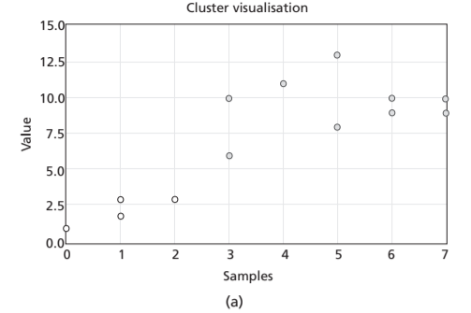
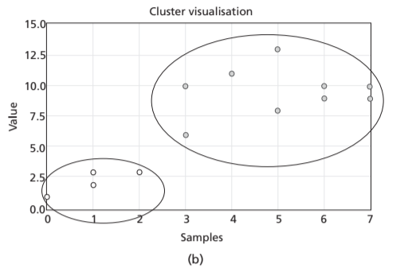
For example,
The following Figure 13.1(a) shows data points or samples with two features shown in different shaded samples and Figure 13.1(b) shows the manually drawn ellipse to indicate the clusters formed.
Points close to each other = Same cluster
Points far from each other = Different clusters

Slide 10
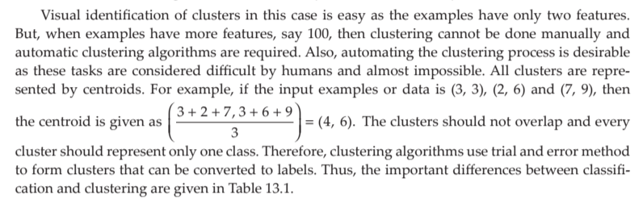
Small data → easy to visualize
Large data → need algorithms
Clusters → represented by centroids
Process → iterative (trial & error)

Slide 11
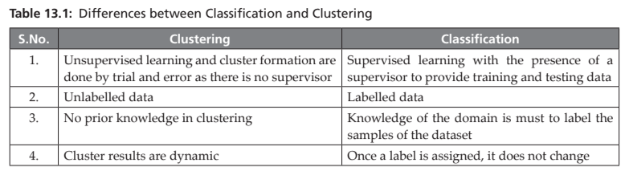

Slide 12
Applications of Clustering
1. Grouping based on customer buying patterns
2. Profiling of customers based on lifestyle
3. In information retrieval applications (like retrieval of a document from a collection of documents)
4. Identifying the groups of genes that influence a disease
5. Identification of organs that are similar in physiology functions
6. Taxonomy of animals, plants in Biology
7. Clustering based on purchasing behaviour and demography
8. Document indexing
9. Data compression by grouping similar objects and finding duplicate objects
Clustering is widely used in business, healthcare, biology, and information systems to group similar data, improve decision-making, and optimize storage and retrieval.

Slide 13
Challenges of Clustering Algorithms
1. High-Dimensional Data Problem
When data has many features (dimensions), clustering becomes difficult.
Example: Instead of 2–3 features, datasets may have 100+ attributes.
Problems:
  Hard to visualize
  Distance measures become less meaningful (curse of dimensionality)
2. Large-Scale Data (Big Data)
With the growth of the internet, billions of data points are generated.
Clustering such large datasets is challenging because:
  Requires high computation time
  Needs efficient memory management
This leads to scalability issues.

Slide 14
Challenges of Clustering Algorithms
3. Scalability Issue
Some clustering algorithms:
  Work well on small datasets
  Perform poorly on large or high-dimensional datasets
Example:
  An algorithm may be fast for 1,000 points but very slow for 1 million points
4. Data Unit Inconsistency
Data may be in different units:
  Example: weight in kg vs pounds
This causes problems because:
  Distance calculations become incorrect or biased
Solution:
  Data normalization/standardization is required before clustering

Slide 15
Challenges of Clustering Algorithms
5. Difficulty in Designing Proximity Measure
Clustering depends on distance/similarity measures (proximity measures)
  Example: Euclidean distance, Manhattan distance
Challenge:
  Choosing the right measure for the data type
Wrong choice → poor clustering results
Clustering faces challenges such as high dimensionality, large-scale data, scalability issues, inconsistent data units, and difficulty in selecting appropriate proximity measures, which affect the performance and accuracy of clustering algorithms.

Slide 16
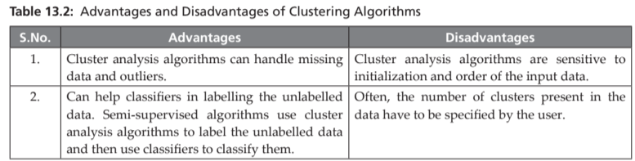
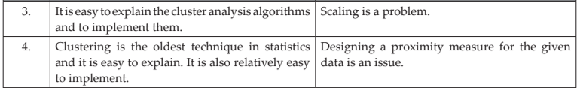

Slide 17
PROXIMITY MEASURES
Why do we need it?
Clustering algorithms group similar objects together.
To do this, they need a way to measure how similar or different two objects are.
What are Proximity Measures?
Proximity measures = a general term for:
  Similarity
  Dissimilarity
They tell us how close or far apart data points are.
Similarity vs Dissimilarity
Similarity Measure
Indicates how alike two objects are
Higher value → more similar
Example: cosine similarity
Dissimilarity Measure
Indicates how different two objects are
Higher value → more different
Example: distance measures

Slide 18
PROXIMITY MEASURES
Distance as a Dissimilarity Measure
Most clustering algorithms use distance measures.
Distance shows how far apart two objects (i and j) are.
Common idea:
Small distance → high similarity
Large distance → low similarity
Example
Suppose:
Object i = (2, 3)
Object j = (5, 7)
Distance between them is large → they are dissimilar
If points are close → they are similar

Slide 19
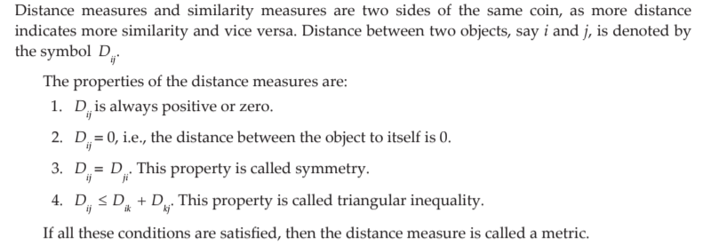

Slide 20
Distance Measure based on Data Types
Clustering distance measures depend on the type of data (attributes) in the dataset.
It can be recollected that the data types are divided into categorical and quantitative variables.
Quantitative variables are numbers and are of two types – nominal and ordinal.
For example, gender is a nominal variable as gender can be enumerated as Gender = {male, female}.
Ordinal variables look like nominal variables but have an inherent order present in the enumeration.
For example, temperature is a nominal variable as temperature can be enumerated as Temperature = {low, medium, high}.
One can observe the inherent order present, that is, medium > low and low < medium.
Quantitative variables are real or Integer numbers or binary data.
In binary data, the attributes of the object can take a Boolean value. Objects whose attributes take binary data are called binary objects.

Slide 21
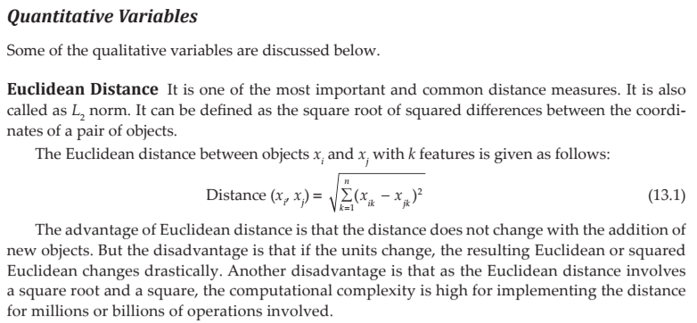
Let us review some of the proximity measures.

Slide 22
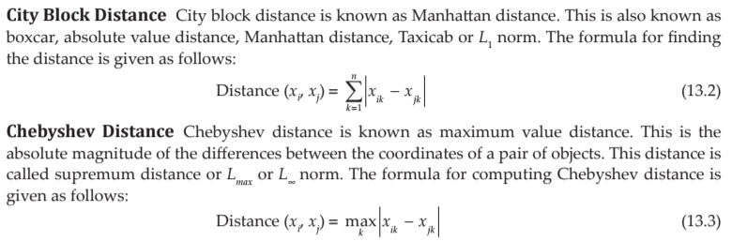

Slide 23
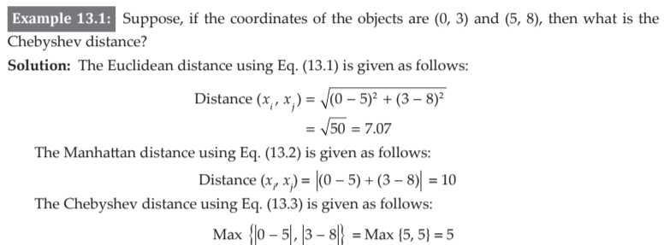

Slide 24

This is called Minkowski distance. Here, r is a parameter.
When the value of r is 1, the distance measure is called city block distance.
When the value of r is 2, the distance measure is called Euclidean distance.
When, r is ∞, then this is Chebyshev distance.

Slide 25
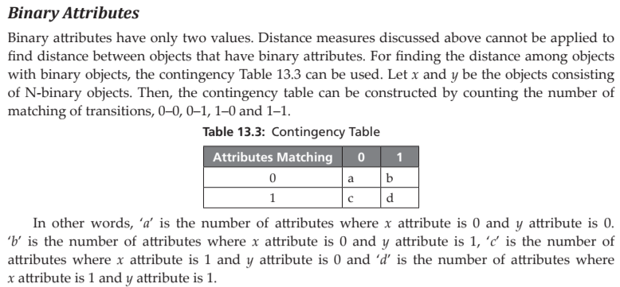

No. of attributes

Slide 26
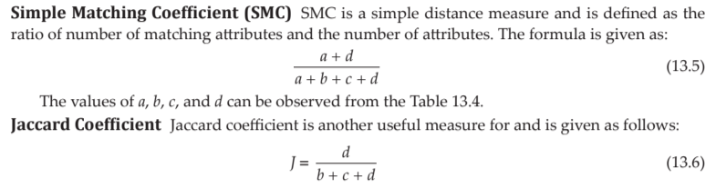

Slide 27
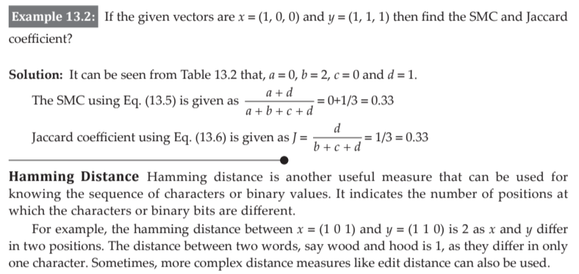
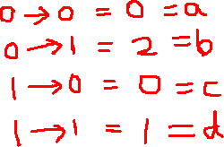

Slide 28
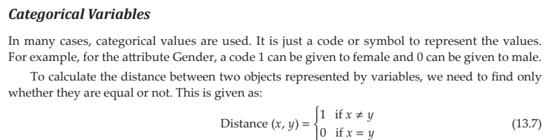

Slide 29
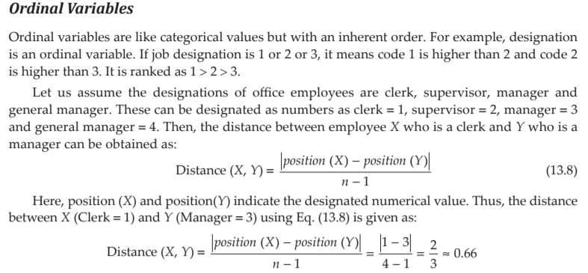
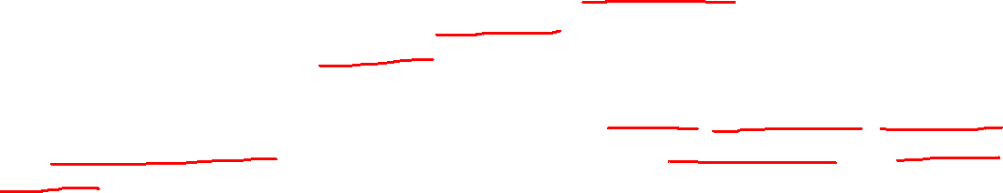

Slide 30
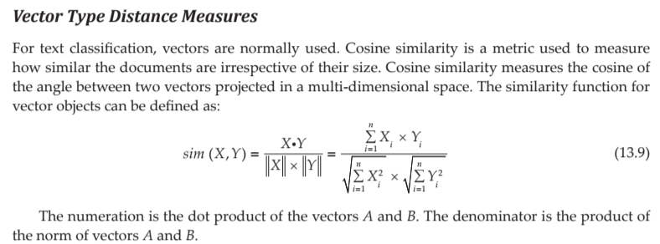
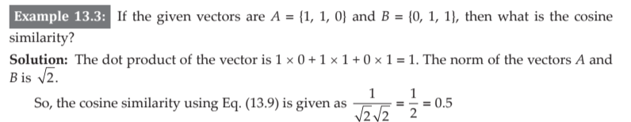

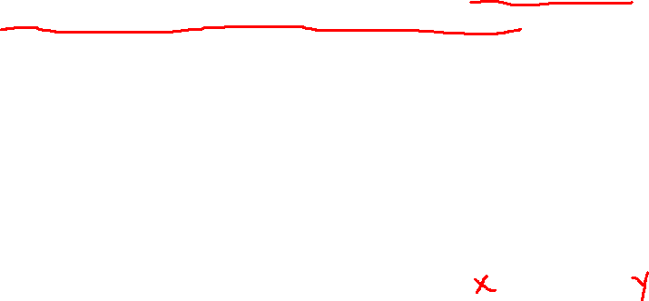

Slide 31
13.3 HIERARCHICAL CLUSTERING ALGORITHMS
Hierarchical clustering is a method of grouping data points into clusters step by step, forming a tree-like structure called a dendrogram.
Think of it like a family tree, where small groups gradually combine into bigger groups.
Main idea:-
It creates a nested structure of clusters
Clusters are formed at different levels (small → big)
Relationships between data points are shown hierarchically

Slide 32
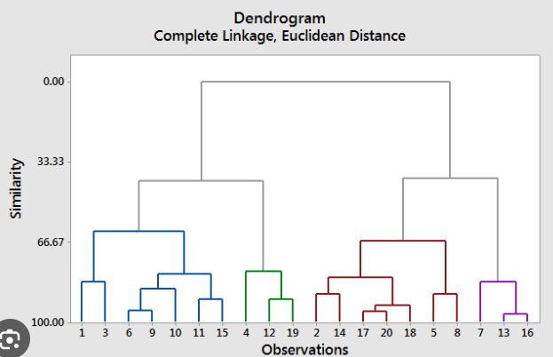
13.3 HIERARCHICAL CLUSTERING ALGORITHMS
Hierarchical methods produce a nested partition of objects with hierarchical relationships among objects. Often, the hierarchy relationship is shown in the form of a dendrogram.
Hierarchical methods include categories, agglomerative methods and divisive methods.
In agglomerative methods, initially all individual samples are considered as a cluster, that is, a cluster with a single element
Then, they are merged and the process is continued to get a single cluster.

Slide 33
Divisive methods use another kind of philosophy, where a single cluster of all samples of the dataset taken initially is chosen and then partitioned.
This partition process is continued until the cluster is split into smaller clusters.
Agglomerative methods merge clusters to reduce the number of clusters.
This is repeated each time while merging two closest clusters to get a single cluster.

Slide 34
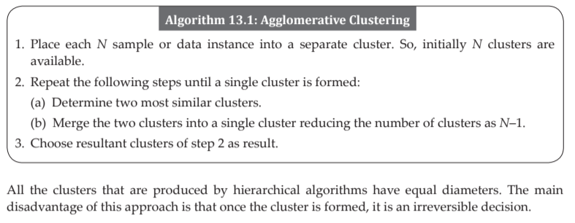
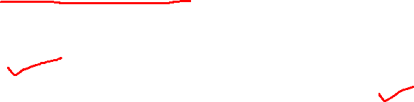

Slide 35
13.3.1 Single Linkage or MIN Algorithm
Hierarchical clustering algorithms produce nested clusters, which can be visualized as a hierarchical tree or dendrogram.
The idea behind this approach is proximity among clusters.
In single linkage algorithm, the smallest distance (x, y), where x is from one cluster and y is from another cluster, is the distance between all possible pairs of the two groups or clusters (or simply the smallest distance of two points where points are in different clusters) and is used for merging the clusters.
In single-link (or single linkage) hierarchical clustering, we merge in each step the two clusters whose two closest members have the smallest distance

Slide 36
This corresponds to finding of minimum spanning tree (MST) of a graph.
The distance measures between individual samples or data points is already demonstrated in the previous section 13.2.
To understand the single linkage algorithm, go through the following numerical problem that involves finding the distance between clusters.

Slide 37
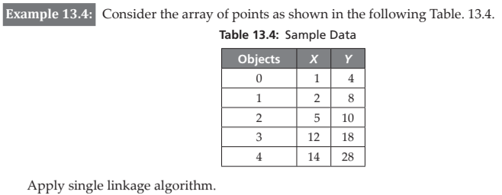

Slide 38
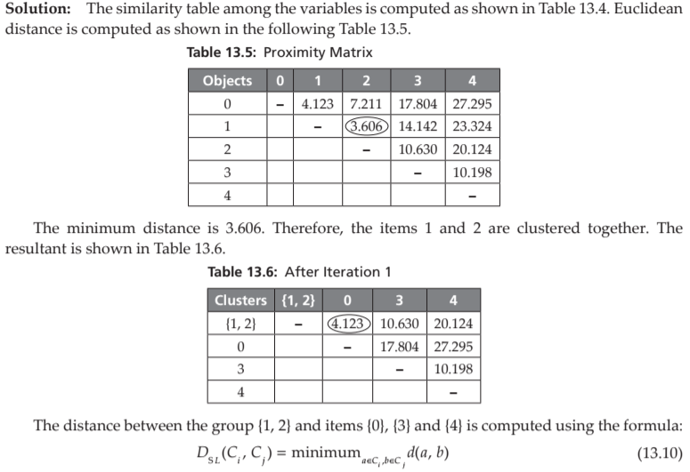
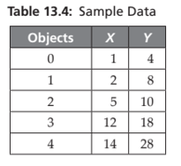

Slide 39
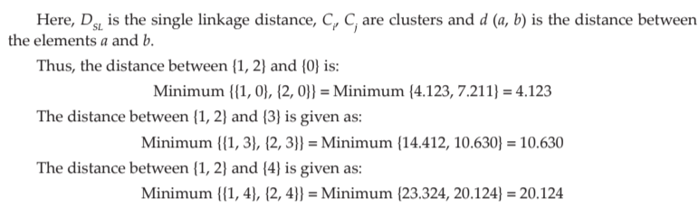

Slide 40
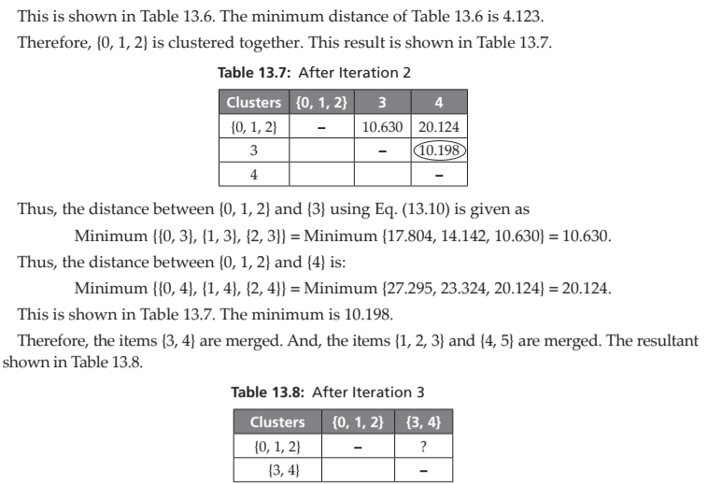

Slide 41
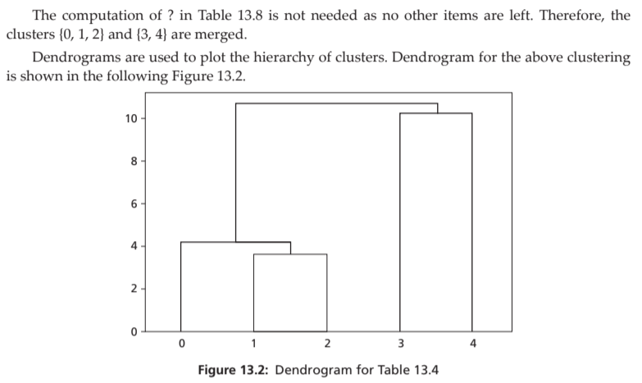

Slide 42
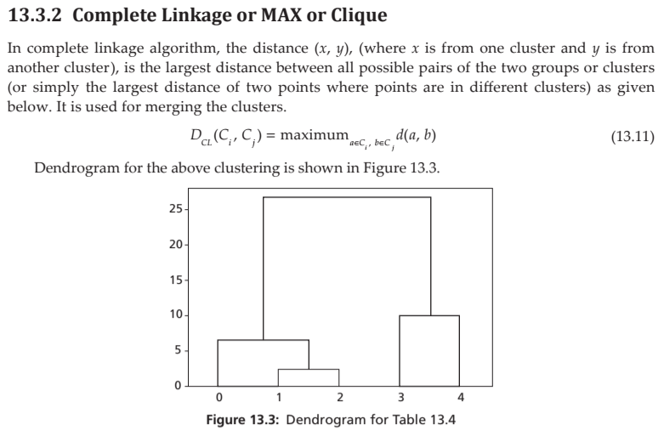

Slide 43
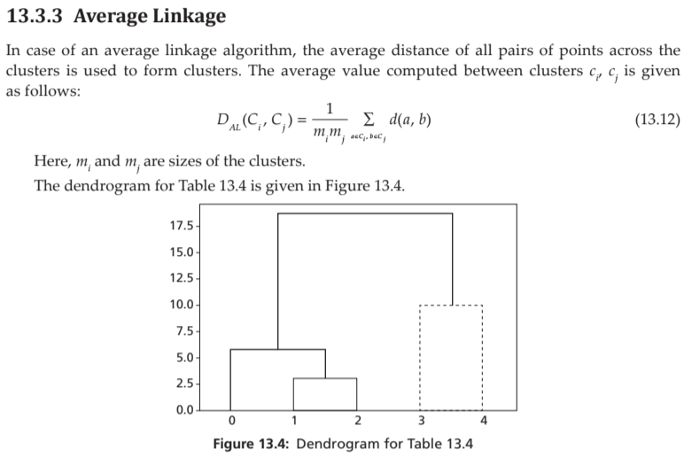

Slide 44
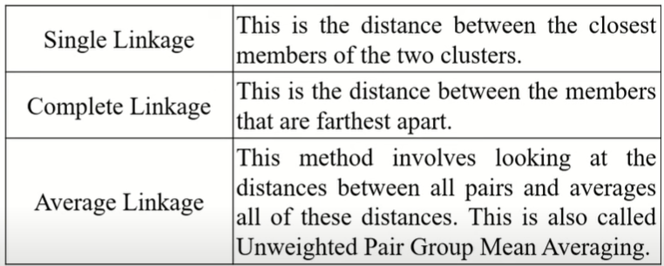

Slide 45
13.3.4 Mean-Shift Clustering Algorithm
Mean-shift is a non-parametric and hierarchical clustering algorithm. This algorithm is also known as mode seeking algorithm or a sliding window algorithm.
It has many applications in image processing and computer vision.
There is no need for any prior knowledge of clusters or shape of the clusters present in the dataset.
The algorithm slowly moves from its initial position towards the dense regions.
The algorithm uses a window, which is basically a weighting function.
Mean-shift algorithm basically assigns the datapoints to the clusters iteratively by shifting points towards the highest density of datapoints i.e. cluster centroid.

Slide 46
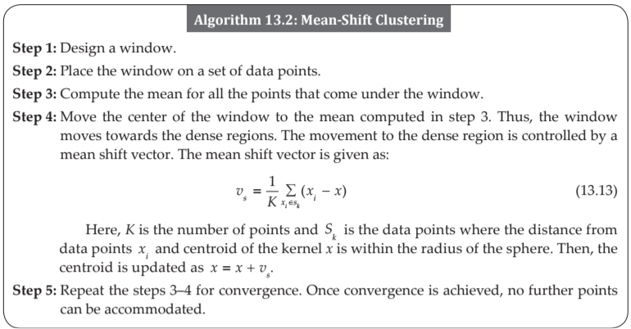

Slide 47
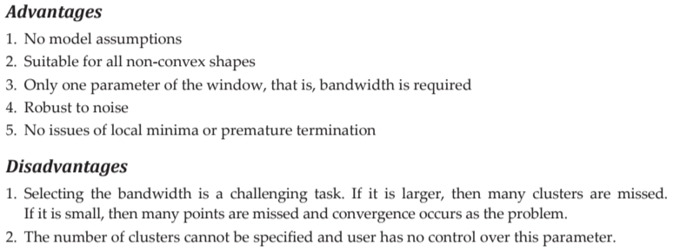

Slide 48
13.4 PARTITIONAL CLUSTERING ALGORITHM
‘k-means’ algorithm is a straightforward iterative partitional algorithm.
Here, k stands for the user specified requested clusters as users are not aware of the clusters that are present in the dataset.
The k-means algorithm assumes that the clusters do not overlap. Therefore, a sample or data point can belong to only one cluster in the end.
Also, this algorithm can detect clusters of shapes like circular or spherical.

Slide 49
Initially, the algorithm needs to be initialized.
The algorithm can select k data points randomly or use the prior knowledge of the data.
In most cases, in k-means algorithm setup, prior knowledge is absent.
The composition of the cluster is based on the initial condition, therefore, initialization is an important task.
The sample or data points need to be normalized for better performance.
The core process of the k-mean algorithm is assigning a sample to a cluster, that is, assigning each sample or data point to the k cluster centers based on its distance and the centroid of the clusters.

Slide 50
This distance should be minimum. As a new sample is added, new computation of mean vectors of the points for that cluster to which sample is assigned is required.
Therefore, this iterative process is continued until no change of instances to clusters is noticed.
This algorithm then terminates and the termination is guaranteed.

Slide 51
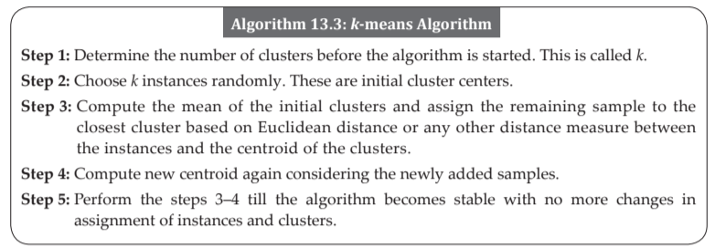

Slide 52
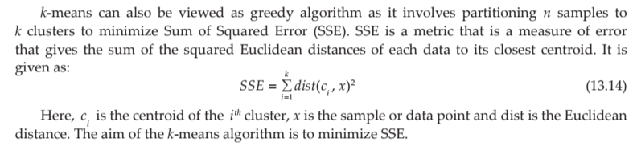
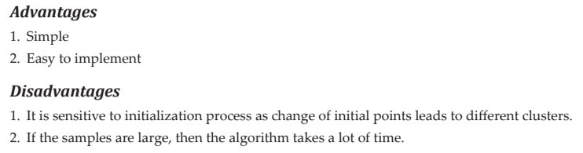

Slide 53
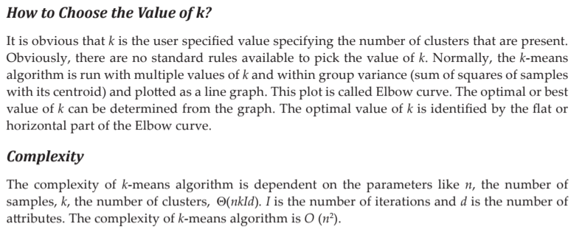

Slide 54
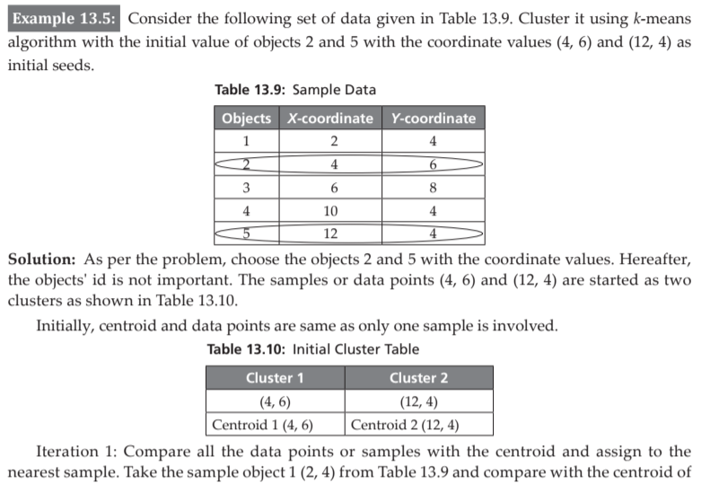
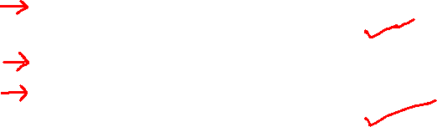

Slide 55
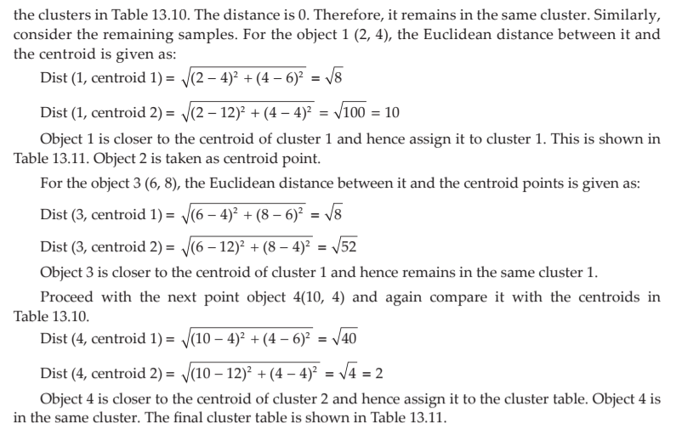
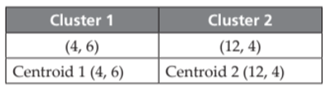


Slide 56
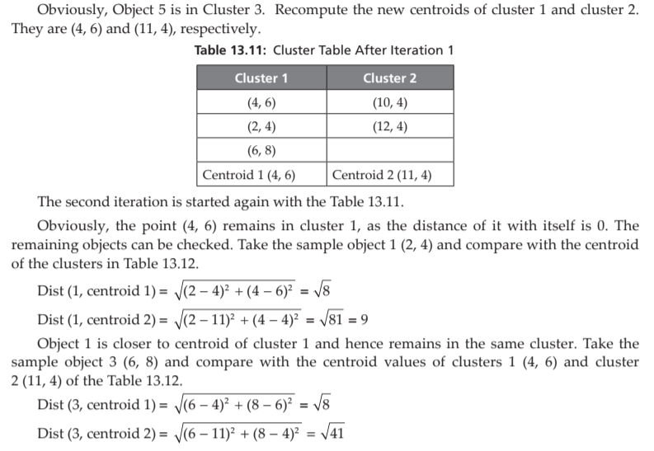
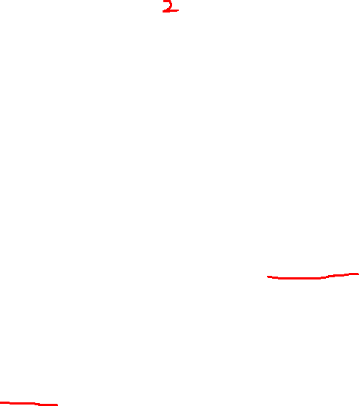

Slide 57
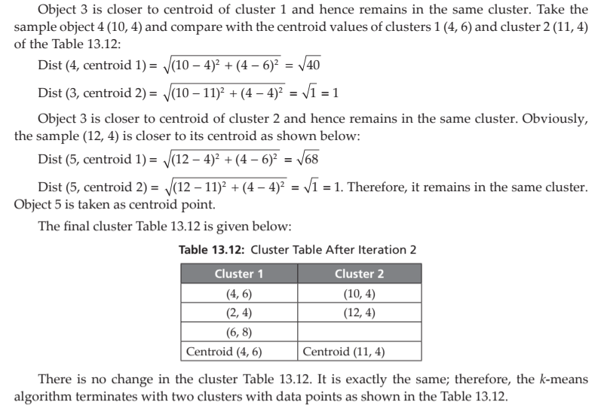

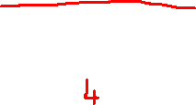

Slide 58
13.5 DENSITY-BASED METHODS
DBSCAN (Density-Based Spatial Clustering of Applications with Noise) is a clustering algorithm that groups data points based on density rather than distance alone.
Key Idea
Instead of forming clusters by shape (like circles in k-means), DBSCAN identifies regions where many points are closely packed together.
Areas with high density → clusters
Areas with low density → noise (outliers)

Slide 59
What is Density?
Density means:
A region where the number of points is greater than a specified threshold within a given distance.
In DBSCAN, two important parameters define this:
ε (epsilon) → radius (distance to search neighbors)
MinPts → minimum number of points required to form a dense region

Slide 60
How clustering algorithm works???
For each point, check how many neighbors are within distance ε.
If neighbors ≥ MinPts → it becomes a core point (start of a cluster).
Points close to core points → added to the cluster (border points).
Points that do not belong to any cluster → noise (outliers).

Slide 61
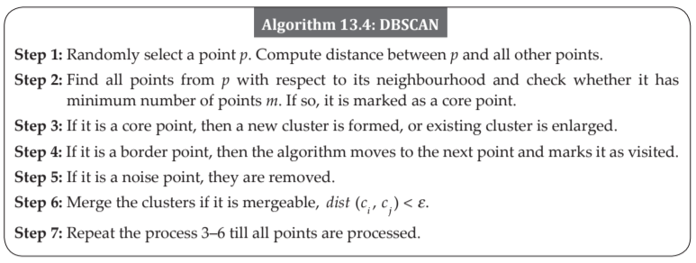

Slide 62


Slide 63


Slide 64


Slide 65
Monotonicity Property
CLIQUE uses anti-monotonicity property or apriori property of the famous apriori algorithm.
It means that all the subsets of a frequent item should be frequent. Similarly, if the subset is infrequent, then all its supersets are infrequent as well.
Based on the apriori property, one can conclude that a k-dimensional cell has r points if and only if every (k – 1) dimensional projections of this cell have atleast r points.
So like association rule mining that uses apriori rule, the candidate dense cells are generated for higher dimensions. The algorithm works in two stages as shown below.

Slide 66



Slide 67
Advantages of CLIQUE
1. Insensitive to input order of objects
2. No assumptions of underlying data distributions
3. Finds subspace of higher dimensions such that high-density clusters exist in those subspaces
Disadvantage
The disadvantage of CLIQUE is that tuning of grid parameters, such as grid size, and finding optimal threshold for finding whether the cell is dense or not is a challenge.

